Slide 1
Version Control
Version control systems, also known as source control, source code management systems, or revision control systems, are a mechanism for keeping multiple versions of your files, so that when you modify a file you can still access the previous revisions.
Version control is a system that records changes to a file or set of files over time so that you can recall specific versions later.
Version Control System (VCS) is a software that helps software developers to work together and maintain a complete history of their work.
Benefits of the Version Control System
The Version Control System is very helpful and beneficial in software development; developing software without using version control is unsafe. It provides backups for uncertainty. Version control systems offer a speedy interface to developers. It also allows software teams to preserve efficiency and agility according to the team scales to include more developers.
Some key benefits of having a version control system are as follows.
Complete change history of the file
Simultaneously working
Branching and merging
Traceability
Types of the version control systems 1. Local Version Control System 2. Centralized Version Control System 3. Distributed Version Control System

Slide 2
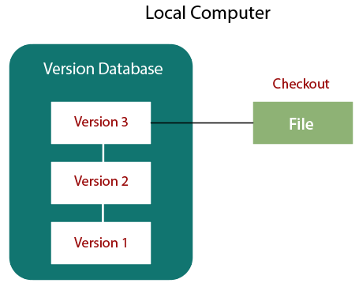
Version Control
Localized Version Control Systems
The localized version control method is a common approach because of its simplicity. But this approach leads to a higher chance of error. In this approach, you may forget which directory you're in and accidentally write to the wrong file or copy over files you don't want to.
To deal with this issue, programmers developed local VCSs that had a simple database. Such databases kept all the changes to files under revision control. A local version control system keeps local copies of the files.
The major drawback of Local VCS is that it has a single point of failure.

Slide 3
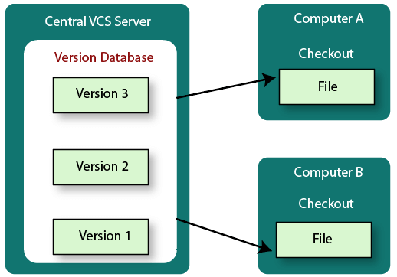
Version Control
Centralized Version Control System
The developers needed to collaborate with other developers on other systems. The localized version control system failed in this case. To deal with this problem, Centralized Version Control Systems were developed.
These systems have a single server that contains the versioned files, and some clients to check out files from a central place.
Centralized version control systems have many benefits, especially over local VCSs.
Everyone on the system has information about the work what others are doing on the project.
Administrators have control over other developers.
It is easier to deal with a centralized version control system than a localized version control system.
A local version control system facilitates with a server software component which stores and manages the different versions of the files.
It also has the same drawback as in local version control system that it also has a single point of failure.

Slide 4
Version Control
Distributed Version Control System
Centralized Version Control System uses a central server to store all the database and team collaboration. But due to single point failure, which means the failure of the central server, developers do not prefer it. Next, the Distributed Version Control System is developed.
In a Distributed Version Control System (such as Git, Mercurial, Bazaar or Darcs), the user has a local copy of a repository. So, the clients don't just check out the latest snapshot of the files even they can fully mirror the repository. The local repository contains all the files and metadata present in the main repository.
DVCS allows automatic management branching and merging. It speeds up of most operations except pushing and pulling. DVCS enhances the ability to work offline and does not rely on a single location for backups. If any server stops and other systems were collaborating via it, then any of the client repositories could be restored by that server. Every checkout is a full backup of all the data.
These systems do not necessarily depend on a central server to store all the versions of a project file.

Slide 5
Difference between Centralized Version Control System and Distributed Version Control System
Centralized Version Control System | Distributed Version Control System
In CVCS, The repository is placed at one place and delivers information to many clients. | In DVCS, Every user has a local copy of the repository in place of the central repository on the server-side.
It is based on the client-server approach. | It is based on the client-server approach.
It is the most straightforward system based on the concept of the central repository. | It is flexible and has emerged with the concept that everyone has their repository.
In CVCS, the server provides the latest code to all the clients across the globe. | In DVCS, every user can check out the snapshot of the code, and they can fully mirror the central repository.
CVCS is easy to administrate and has additional control over users and access by its server from one place. | DVCS is fast comparing to CVCS as you don't have to interact with the central server for every command.
The popular tools of CVCS are SVN (Subversion) and CVS. | The popular tools of DVCS are Git and Mercurial.
CVCS is easy to understand for beginners. | DVCS has some complex process for beginners.
If the server fails, No system can access data from another system. | if any server fails and other systems were collaborating via it, that server can restore any of the client repositories

Slide 6
Version Control
Popular Version Control Systems
SVN: SVN is the abbreviated form of “Apache Subversion” and is a popular version control system tool. It is a centralized version control system and is system distributed and collaborated with open source license. The official website is as follows: https://subversion.apache.org/
Git: Git is the distributed version control system and has an emphasis on speed and performance. It is supported by all operating systems. Git is open source software distributed under the terms of the GNU (General Public License).
The official website is as follows: https://git-scm.com/
TFS:Team Foundation Server (TFS) is a product of Microsoft that helps its users in multiple ways and positions in the SDLC source code management, reporting, requirement management, project management, automated builds, and release management.

Slide 7
Version Control
Popular Jargons Related To Version Control System:
Repository: It can be described as the heart of any version control system. Repository is the central defined place where all the developers or programmers work and store their code. Apart from storing files, repositories also maintain the history. In version control systems, repositories are accessed over a network which acts like a server and version control tool as a client. On establishing successful connection, clients store or retrieve their changes.
Trunk: Trunk can be defined as a directory where all the development takes place. All the check-outs are committed by the developers.
Branches: Branches of the repository are like branches of the tree. The operation of creating branches are used to create another like of development. It is proved beneficial when your development process forks in two directions.
Working copy: It is the snapshot of the repository where the developer is actively working on it. Each developer has their own working copy. The changes made in the working copy are merged together in the main repository. Working copy can be considered as a private workplace where developers maintain their work in systematic way which is isolated from the rest of the developers.

Slide 8
Version Control
Commit changes: Committing code is the process of storing changes from working copy to the central server. After successful commit changes are made available to all the team members. Other developers can pull these changes which will update the working copy. Commit is an atomic operation which means either it is successful or rolled back. Developers can never see half-finished commit.

